Slide 1
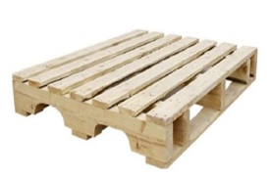
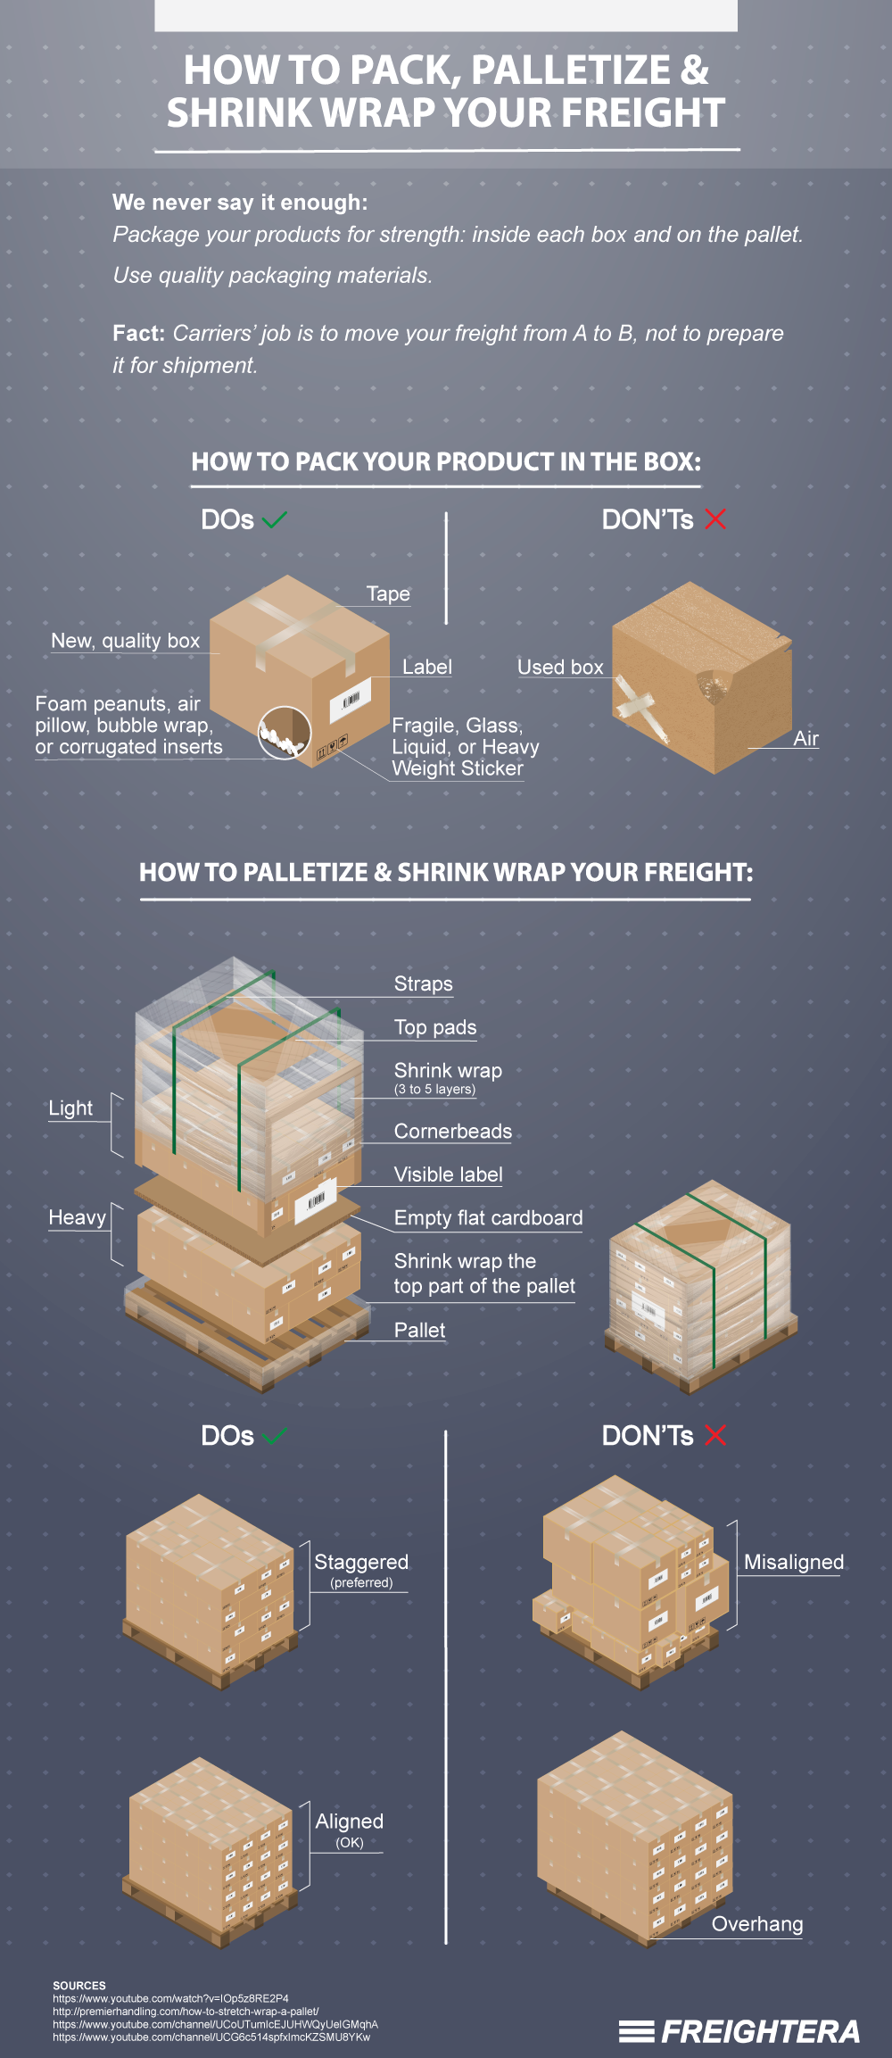
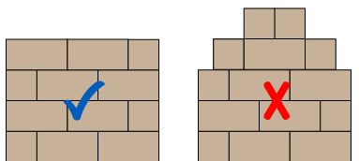
FleetPride Packaging and Shipping Guidelines for Import Vendors
Master Case Packaging and Labeling
Pallet Specifications and Carton Stacking
Transportation
Carton requirements: It is the supplier’s responsibility to ensure that the carton strength is strong enough to protect the product for shipments to the final destination , Distribution Center or branch location.
Product label must clearly show
Supplier name and address
Fleetpride ship to location and address
Purchase order number
FleetPride Part number
Total Piece Quantity
Carton number and total of number of cartons
Pallet Specifications
Measurement – 48” deep x 42” or 40” wide 4-way entry, hardwood construction.
Top Deck Boards – 7 boards, 5/8” to ¾” evenly spaced with 4”maximum spacing: both end boards 5 ½”, other boards 3 ½”.
Bottom Deck Boards – Both end boards and a minimum of 3 center boards are to be the same board dimensions as top deck boards. No loose boards.
Stringers – No split or broken; no double stringers or block patched stringers; stringers 1 3/8” to 1 ¾” x 3 ½” to 3 ¾” x 48”; no protruding nails.
Avoid use of plywood and composite wood materials for pallet
Consolidate POs by Ship-To Address
All POs to same Ship-To address must be shipped together
Each Pallet must have at least two labels on adjacent sides identifying
  Ship from address
  Ship to address
  Distribution center 2 digit location and matching color coding
  PO Number(s)
  Pallet number and total pallet count per DC
Pallet Labels Color Coding
DC Location Label Color
AT Yellow
BB Green
NH Blue
DA Red
VS Grey
Other White
Master Case Label Example:
Carton Stacking
Use boxes strong enough for multiple handling and transportation
Small product on top layers of the pallet
Large product on bottom of pallet
No overhang of cartons
Use liner paper between layers when appropriate
Corner board for protection preferred
Shrink wrap the whole pallet and use straps when necessary
Supplier name and
address
FleetPride Ship To
Location and Address
Pallet Label Example:
Purchase order number
Ship From Address Goes Here:
Ship To Address Goes Here:
Pallets Label must use a dot Sticker (minimum 2 inches diameter) or printed on colored paper)
Fleetpride part number
DA
PO Number(s)
Total piece quantity
Carton _ of __
Pallet _ of __
Detailed guidelines available at www.fleetpride.com/brands-vendors/FPPS
Secure Product to Pallet
Use straps
Use strong shrink wrap

